Slide 1

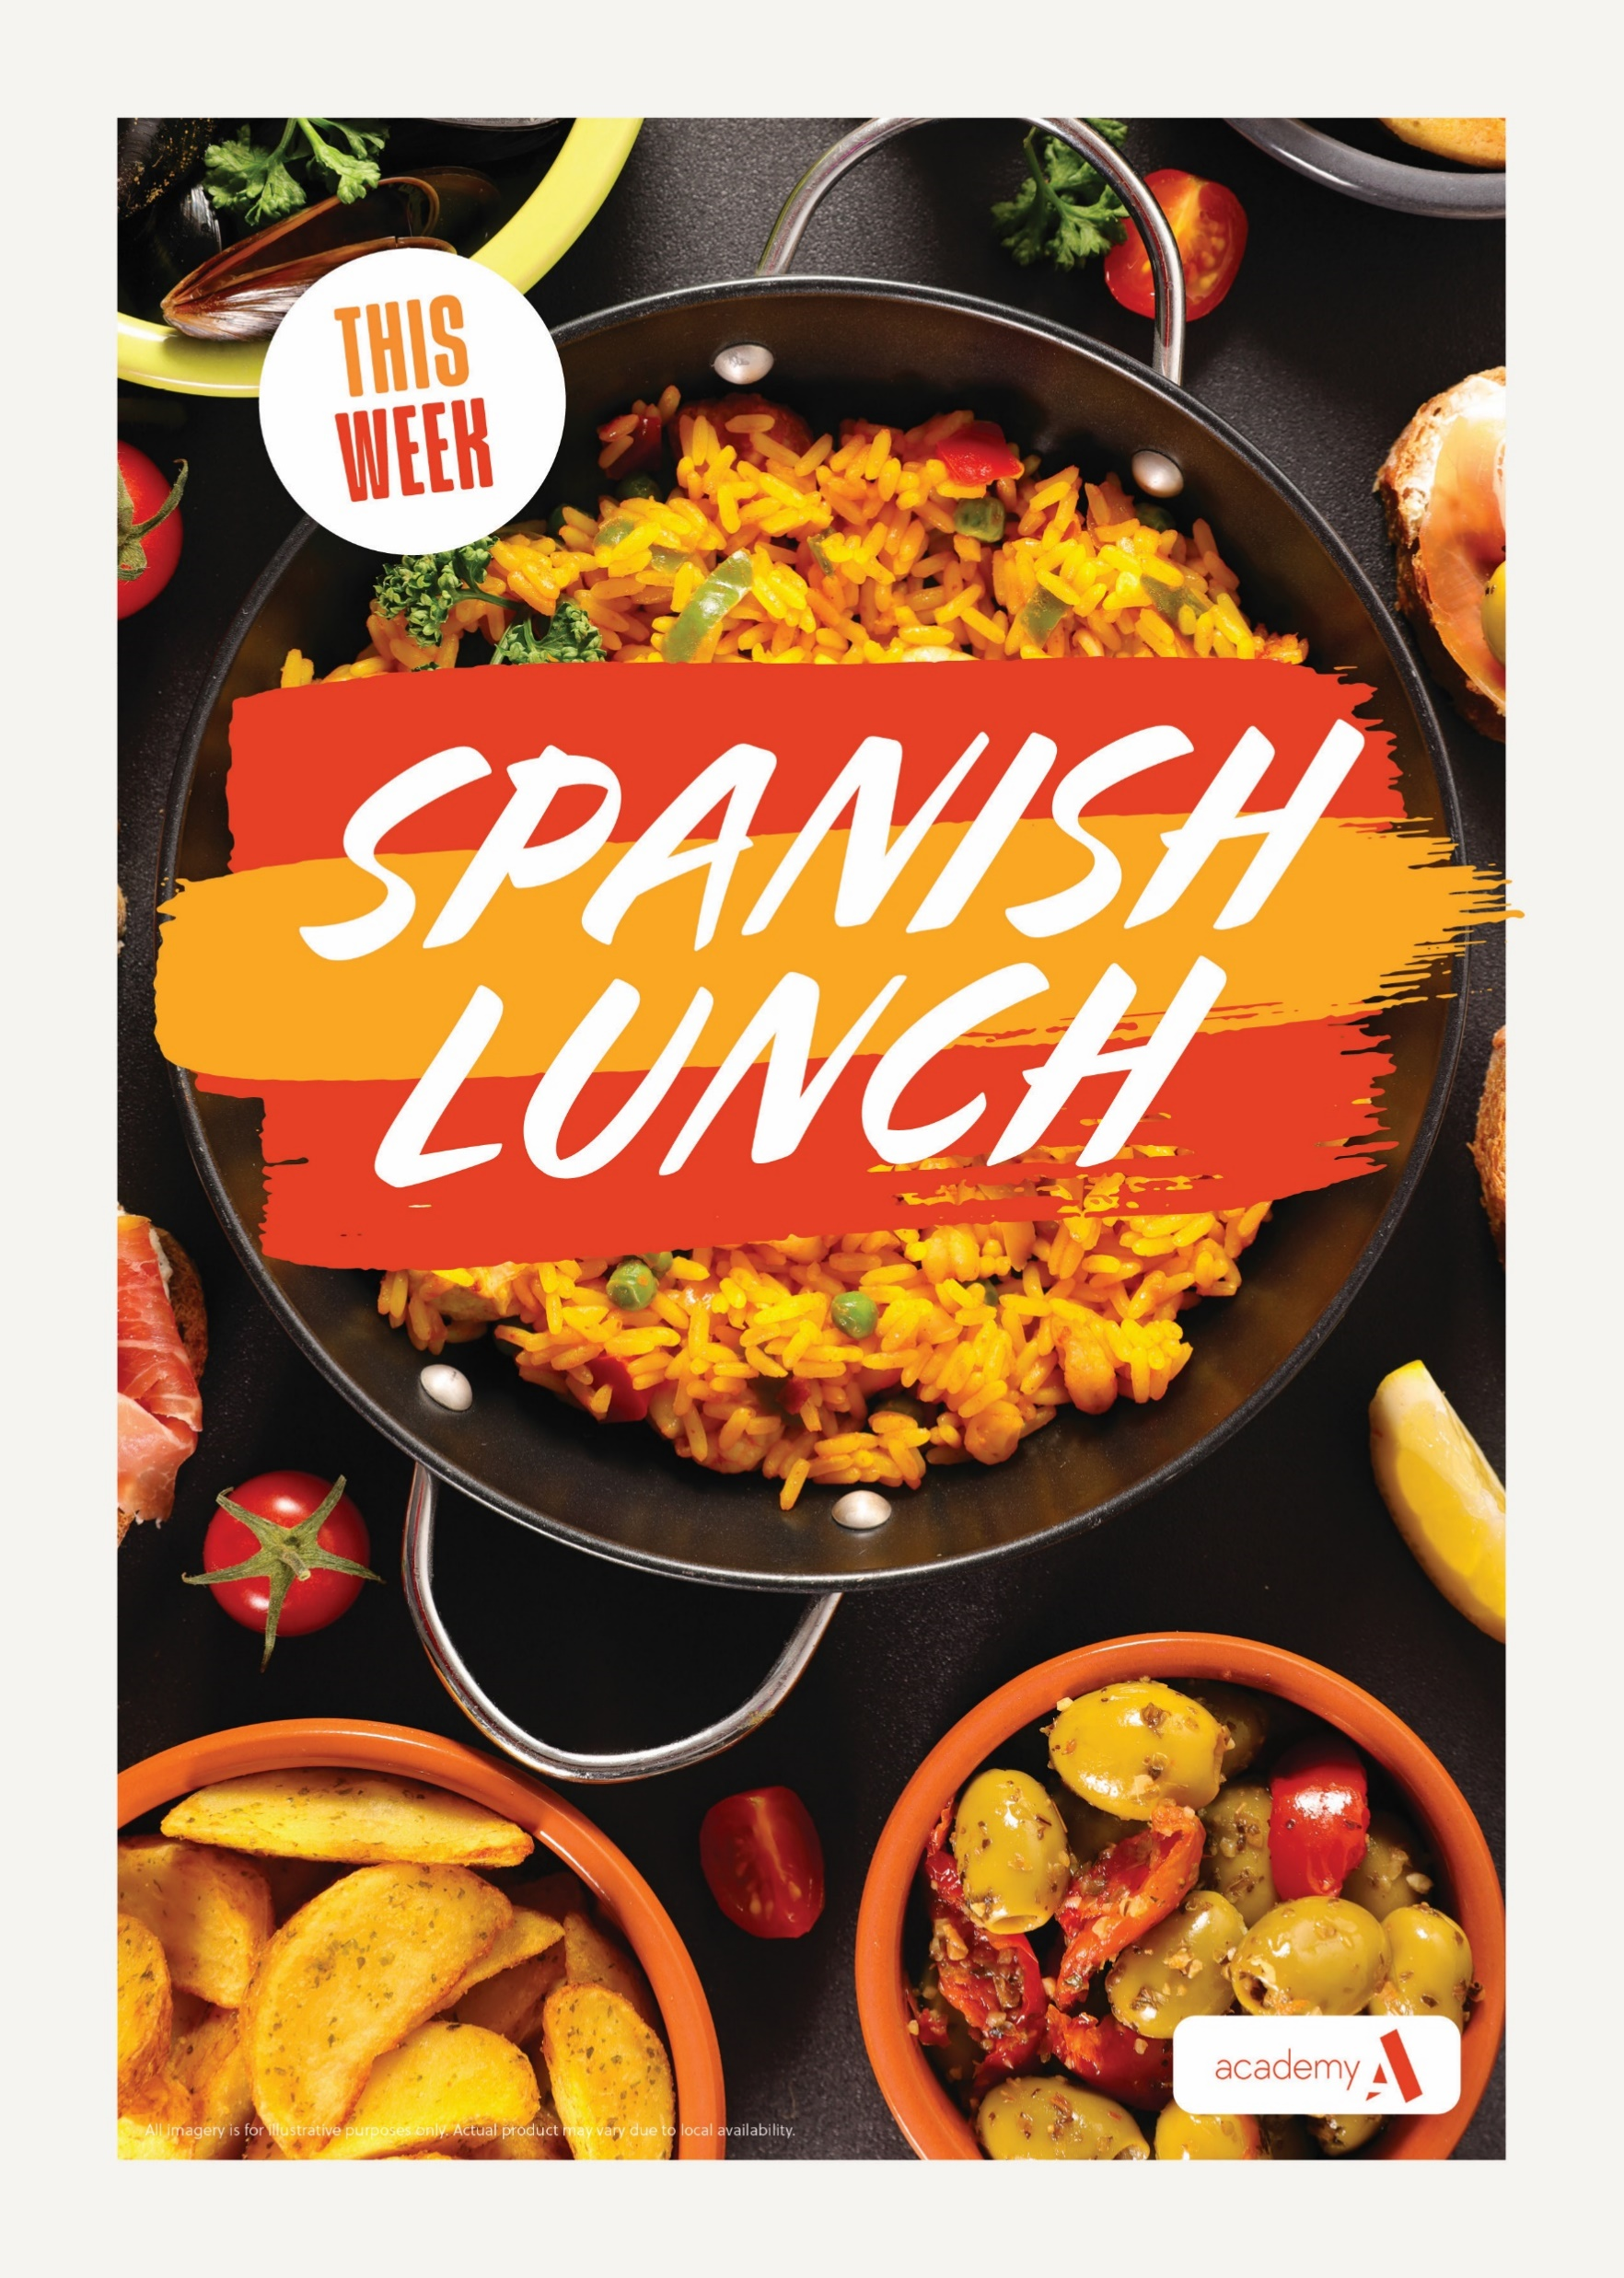









RIDGEWOOD SEASONAL KITCHEN
Main Counter Tariff
New
for
September
2026
MENU ITEM | PRICE
Meal Deal, Main Meal | £2.05
Meal Deal Main Drink or Cake | £2.66
Meal Deal Main Meal Cake &Drink | £3.05
Wrap Shack Meal | £2.05
Wrap shack Meal Drink or Cake | £2.66
Wrap Shack Meal Drink & Cake | £3.05
Pizza & Wedges Meal | £2.05
Pizza & Wedges Meal Dink or Cake | £2.66
Pizza & Wedges meal Drink & Cake | £3.05
Pasta Pot Pasta & Sauce | £2.05
Pasta Pot Drink or Cake | £2.66
Pasta Pot Drink &Cake | £3.05
AVAILABLE
DAILY
SNACK SHACK
Freshly Made
Wraps with a choice of fillings
COMING Soon
FOOD ALLERGIES
& INTOLERANCES
If you require information on
allergens or suffer
from a food intolerance, please speak to a team member before you order food or drinks

Slide 2

RIDGEWOOD SEASONAL KITCHEN
Main Counter Tariff
Morning Break | PRICE
Toast x 1 or x 2 Slices | 35p/60p
Hash Brown | 55p
Breakfast Wrap | £2.00
Cheese Toastie | £1.50
Pain au Choc | £1.20
Half Bacon or Sausage Baguette | £1.45
Bagel | £1.25
Sweet Waffle | £1.10
Sausage Roll | £1.70
Break Pizza | £1.35
Fruit Pot/Yoghurt pot | £1.00
Tater Tots | £1.00
Croissant | £1.20
New
for
2026
AVAILABLE
DAILY
GRAB ‘N’ GO
Station
+
Jacket Potatoes
+ Fresh Salads
Freshly Made Sandwiches &
& Baguettes
Selection of meat,
fish & vegetarian
Freshly Made
Paninis
COMING Soon
FOOD ALLERGIES
& INTOLERANCES
If you require information on
allergens or suffer
from a food intolerance, please speak to a team member before you order food or drinks

Slide 3
RIDGEWOOD SEASONAL KITCHEN
6th Form Break Tariff
Morning Break | PRICE
Toast x 1 or x 2 Slices | 35p/60p
Hash Brown | 55p
Breakfast Wrap | £2.00
Cheese Toastie | £1.50
Pain au Choc | £1.20
Half Bacon or Sausage Baguette | £1.45
Bagel | £1.25
Sweet Waffle | £1.10
Sausage Roll | £1.70
Break Pizza | £1.35
Fruit Pot/Yoghurt pot | £1.00
Tater Tots | £1.00
Croissant | £1.20
New
for
2026
AVAILABLE
DAILY
GRAB ‘N’ GO
Station
Jacket Potatoes
+ Fresh Salads
Freshly Made Sandwiches &
& Baguettes
Selection of meat,
fish & vegetarian
Freshly Made
Paninis
COMING Soon
FOOD ALLERGIES
& INTOLERANCES
If you require information on
allergens or suffer
from a food intolerance, please speak to a team member before you order food or drinks

Slide 4
RIDGEWOOD SEASONAL KITCHEN
Drinks Tariff
New
for
2026
MENU ITEM | PRICE
Still Water 330ml | 80p
Still Water 500 ml | £1.05
Large flavoured Water | £1.05
Radnor Fizz | £1.05
Fruit Juice Carton | £1.30
Milk Shake Carton | £1.05
Slushie | £1.30
AVAILABLE
DAILY
GRAB ‘N’ GO
Station
Jacket Potatoes
+ Fresh Salads
Freshly Made Sandwiches &
& Baguettes
Selection of meat,
fish & vegetarian
Freshly Made
Paninis
COMING Soon
FOOD ALLERGIES
& INTOLERANCES
If you require information on
allergens or suffer
from a food intolerance, please speak to a team member before you order food or drinks

Slide 5
RIDGEWOOD SEASONAL KITCHEN
Grab ‘N’ Go Tariff
New
for
2026
MENU ITEM | PRICE
Sandwiches From | £1.80
Wrap’s From | £2.20
Meat Panini | £2.20
Vegetarian Panini | £2.00
Sides/Extras
Chips/Potatoes/Pasta | £1.20
Baked Beans/Vegetables | 60p
Gravy | 30p
Curry Sauce | 50p
AVAILABLE
DAILY
GRAB ‘N’ GO
Station
Jacket Potatoes
+ Fresh Salads
Freshly Made Sandwiches &
& Baguettes
Selection of meat,
fish & vegetarian
Freshly Made
Paninis
COMING Soon
FOOD ALLERGIES
& INTOLERANCES
If you require information on
allergens or suffer
from a food intolerance, please speak to a team member before you order food or drinks

Slide 6
RIDGEWOOD SEASONAL KITCHEN
Cakes and Bakes
New
for
2026
MENU ITEM | PRICE
Cookie | £1.15
Mini Biscuits | 55p
Homemade Tray Bake | £1.15
Muffin | £1.15
Cake of the Day | £1.50
Popcorn | £1.25
AVAILABLE
DAILY
GRAB ‘N’ GO
Station
Jacket Potatoes
+ Fresh Salads
Freshly Made Sandwiches &
& Baguettes
Selection of meat,
fish & vegetarian
Freshly Made
Paninis
COMING Soon
FOOD ALLERGIES
& INTOLERANCES
If you require information on
allergens or suffer
from a food intolerance, please speak to a team member before you order food or drinks

Slide 7
RIDGEWOOD SNACK SHACK
Tariff
MENU ITEM | PRICE
Wrap Shack Meal | £2.05
Wrap shack Meal Drink or Cake | £2.66
Wrap Shack Meal Drink & Cake | £3.05
New
for
2026
AVAILABLE
DAILY
GRAB ‘N’ GO
Station
MENU ITEM | PRICE
Cookie | £1.15
Mini Biscuits | 55p
Homemade Tray Bake | £1.15
Popcorn | £1.25
Jacket Potatoes
+ Fresh Salads
Freshly Made Sandwiches &
& Baguettes
Selection of meat,
fish & vegetarian
Freshly Made
Paninis
MENU ITEM | PRICE
Still Water 500 ml | £1.05
Large flavoured Water | £1.05
Radnor Fizz | £1.05
COMING Soon
FOOD ALLERGIES
& INTOLERANCES
If you require information on
allergens or suffer
from a food intolerance, please speak to a team member before you order food or drinks

Slide 8
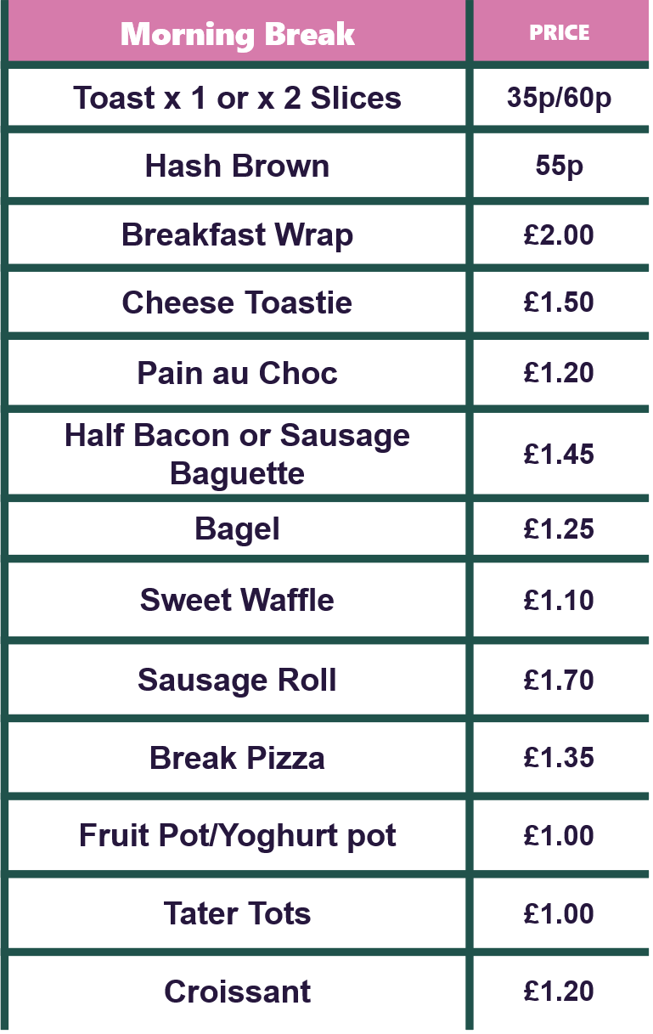
RIDGEWOOD SNACK SHACK
Break Tariff
New
for
2026
AVAILABLE
DAILY
GRAB ‘N’ GO
Station
Jacket Potatoes
+ Fresh Salads
Freshly Made Sandwiches &
& Baguettes
Selection of meat,
fish & vegetarian
Freshly Made
Paninis
COMING Soon
FOOD ALLERGIES
& INTOLERANCES
If you require information on
allergens or suffer
from a food intolerance, please speak to a team member before you order food or drinks

