Slide 1
Welcome – Post 18 Options
This evening’s speakers:
Chris Stead – University of Sheffield
Student finance for University
Suzanne Wilks – Doncaster Council
Higher and Degree Apprenticeships

Slide 2
STUDENT FINANCE AND MANAGING YOUR MONEY
Notes:
TITLE SLIDE - GUIDANCE NOTES:
Use this slide at the start of every presentation. To change the ‘hero image’, right-click the slide (in the left panel) and select ‘Apply layout’. Choose any layout called ‘Title Slide’.
Please do not…
Change the font, colour or size of text.
Move the text box or make it bigger/smaller.
Please make sure…
All text is in capital letters.

Slide 3
OVERVIEW
Student loans
Applying
Repayments
Support
Alternative sources of income and managing your money
3
Notes:
STANDARD SLIDE (TITLE AND TEXT) - GUIDANCE NOTES:
Use this slide for generic ‘text-only’ content.
Please do not…
Change the font or colour of the text.
Move the text box or make it bigger/smaller.
Please make sure…
Title text is in capital letters.
All text is accessible in size (no smaller than Xpt).

Slide 4

GOVERNMENT SUPPORT
Notes:
SECTION HEADER SLIDE - GUIDANCE NOTES:
Use this slide to mark a new section of your presentation.
Please do not…
Change the font, colour or size of text.
Change the size or shape of the image box.
Move the text box or make it bigger/smaller.
Please make sure…
All text is in capital letters.
Image box is completely filled and scaled proportionally.

Slide 5

WHAT WILL IT COST?
Tuition fee (£9,790 per year):
Covers all essential course costs
Maintenance costs:
Accommodation
Study materials
Food and drink
Social activities
www.sheffield.ac.uk/new-students/tuition-fees

Slide 6

TUITION FEE LOAN
The government will always cover the cost of your tuition fees each year.
You won’t pay anything upfront
Not based on your household income
You can borrow ‘part’ of the loan
£9790 per year
6
Notes:
So for your tuition fee loan …
●You receive the set amount to cover the amount your university has set out as their fee amount. You don’t physically receive this money, it goes straight to the university in three installments to pay off the fee every year of your course.
●Universities can’t increase fees until 2025
●You don’t have to pay anything upfront and the money is not linked to household income or where you live.

Slide 7

MAINTENANCE LOAN
Based on your household income
Amount depends on location and whether you live with parents/carers.
Paid directly into your bank account in 3 separate instalments (once a term)
7
Notes:
Then as I mentioned previously, you receive a maintenance loan and this counts towards your living costs.
So your maintenance loan is based on household income, unlike the tuition fee loan. Your receive this money in 3 instalments – 1. at the start of your course 2. around Christmas and 3. at Easter.
This money contributes towards your accommodation, travel, books etc and everyone who attends university gets something, however you may find that it does not cover it all. You will be able to check the amount of Maintenance Loan you’re eligible for, depending on your household income, on the Student Finance website, or when you make you application for Student Finance online.
One thing I’d like to mention, if you choose you study abroad or do a year in industry as part of your degree, your tuition fee is reduced and you will still receive your maintenance loan.

Slide 8
MAINTENANCE LOAN AMOUNTS 26/27*
Household income (HI) | Living at home HI threshold for minimum loan amount= £58,348 | Living away from home HI threshold for minimum loan amount = £62,358 | Living away from home (in London) Threshold for min loan= £70,106
£25,000 or less | £9,118 | £10,830 | £14,135
£35,000 | £7,589 | £9,285 | £12,563
£45,000 | £6,060 | £7,739 | £10,991
£58,348 | £4,019 (minimum loan) | £5,676 | £8,892
£62,358 | £4,019 | £5,056 (minimum loan) | £8,262
£70,106+ | £4,019 | £5,056 | £7,043 (minimum loan)
*Based on 2026 entry, 2027 entry figures tbc
www.gov.uk/student-finance-calculator
8
Notes:
Then as I mentioned previously, you receive a maintenance loan and this counts towards your living costs.
●So your maintenance loan is based on household income, unlike the tuition fee loan. Your receive this money in 3 instalments – 1. at the start of your course 2. around Christmas and 3. at Easter.
●This money contributes towards your accommodation, travel, books etc and everyone who attends university gets something, however you may find that it does not cover it all. You will be able to check the amount of Maintenance Loan you’re eligible for, depending on your household income, on the Student Finance website, or when you make you application for Student Finance online.
●One thing I’d like to mention, if you choose you study abroad or do a year in industry as part of your degree, your tuition fee is reduced and you will still receive your maintenance loan.

Slide 9
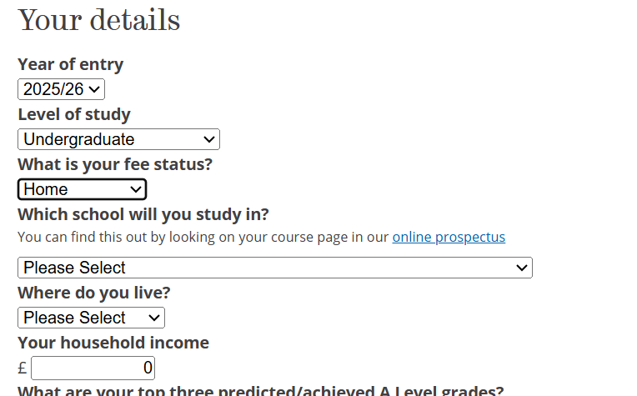
HOW MUCH FUNDING WILL I GET?
Calculators:
sheffield.ac.uk/funding/calculator
www.gov.uk/student-finance-calculator
9
Notes:
An easy way to check for what you are eligible for is to complete the student finance calculator using the link above.
●This will give you an idea of how much you will get if you do choose to come to university

Slide 10
APPLYING
Notes:
Firstly I’m going to talk about how Student Finance works in the UK.

Slide 11
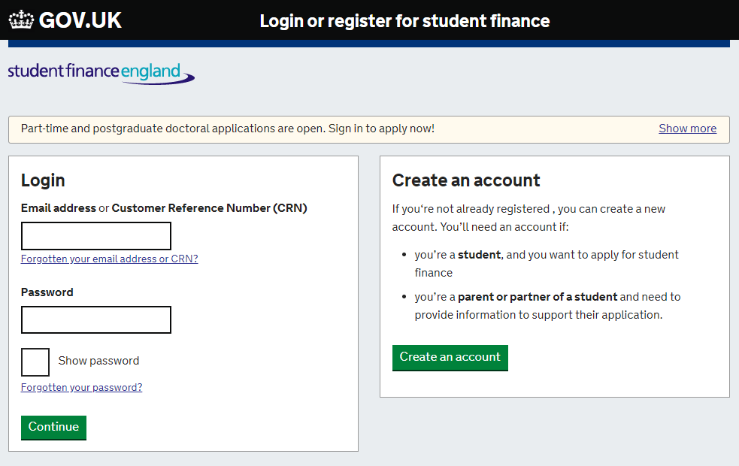
APPLYING FOR STUDENT FINANCE
Apply in the spring before you start your course, or as soon as possible after that.
Applications for 2026 entry are planned to open in March
Apply as soon as possible
You don’t need a confirmed place to apply
www.gov.uk/apply-online-for-student-finance
11
Notes:
You apply for your student loan through the student finance England website and not through UCAS. You complete your application online around the March before your year of entry. Applications open in March 2025.
The system is very straight forward and much simpler to what it was say 5 years ago. Even if you are not sure about if or when you want to go to university, you still need to make your application as you are not tied into anything if you choose not to attend that year. Can easily edit your application if you don’t go to your first choice University
Important to meet the deadline too = SFE guarantee to have all your finance in place by the time you start your course
You do not need to have a firm place at a university to student finance- apply earlier
DSA- Currently it is talking 3 months+ to process a DSA application
UCAS will normally send updates ‘student finance applications are now open’ - applications for any government funding
Tuition fee loan needs to be applied for every year of study - useful to apply with an email address that you will be able to access after you have left school/ college
Perhaps a professional email address you have made for your UCAS application

Slide 12
REPAYMENTS
Notes:
SECTION HEADER SLIDE - GUIDANCE NOTES:
Use this slide to mark a new section of your presentation.
Please do not…
Change the font, colour or size of text.
Change the size or shape of the image box.
Move the text box or make it bigger/smaller.
Please make sure…
All text is in capital letters.
Image box is completely filled and scaled proportionally.

Slide 13

REPAYMENTS
Students only start repaying after they graduate.
Monthly repayments depend on what individuals earn, not what they have borrowed.
Individuals don’t pay anything until earnings exceed £25,000 a year.
13
Notes:
So your student loan is made up of your tuition fee loan and your maintenance loan combined at the end of your degree.
Repayments start the April after you leave university and only when you are earning over £25,000. This means that for whatever reason in your working life your salary goes under the threshold amount, you will stop paying your student loan.
When you start to repay your student loan, there will be interest charged however it is important to mention that the interest rate is much lower than a bank loan.
And anything that is unpaid after 40 years is written off.

Slide 14
REPAYMENTS
Repayments start the April after individuals leave university
When individuals earn over £25,000 a year
Interest will be generated on a student loan when the first instalment is paid.
Anything unpaid after 40 years is written off
If income falls to £25,000 or below, repayments stop automatically
Loan doesn’t affect credit ratings
Repayments can be made early
Tuition fee loan
+
Maintenance loan
= Student loan
Notes:
So your student loan is made up of your tuition fee loan and your maintenance loan combined at the end of your degree.
Repayments start the April after you leave university and only when you are earning over £25,000. Repayments are currently calculated as 9% of any income above this.This means that for whatever reason in your working life your salary goes under the threshold amount, you will stop paying your student loan.
Eg income = £28,000. Income above £25,000 = £3,000. 9% of £3,000 = £270, £22.50 a month.
When you start to repay your student loan, there will be interest charged however it is important to mention that the interest rate is much lower than a bank loan.
And anything that is unpaid after 40 years is written off.
The interest rate will normally be based on the Retail Price Index (RPI).
The student loan from the government is different to usual loans. The loan is never passed on to anyone else; no one else will ever be responsible for paying it back. Also, it doesn’t have a negative effect on your credit rating – so when you apply for mortgages or credit cards in the future, the balance of your student loan won’t be considered.
https://www.gov.uk/apply-online-for-student-finance

Slide 15
INTEREST
The interest rate is set at RPI (retail price index).
Interest is charged on your student loan from when the first instalment is paid.
The amount of interest you’re charged doesn’t affect the amount you’ll repay each month.
15
Notes:
The interest rate is based on the Retail Price Index or RPI, which measures changes to the cost of living in the UK. The interest rate is updated once a year in September, using the RPI from March of that year.
RPI (retail price index) is essentially a measure of inflation
It’s important to remember that the amount of interest you’re charged doesn’t affect the amount you’ll repay each month. How much interest you’re charged depends on your circumstances.

Slide 16
HOW WILL I PAY?
Monthly student finance repayments are managed by your employer.
The money will come out of your wages before they even get to you.
If you’re self employed, HMRC will work out how much you need to pay from your tax return, and you’ll pay at the same time you pay your tax.
16

Slide 17
REPAYMENT EXAMPLES
9% on earnings over £25,000 per year
Yearly income before tax | Monthly income before tax | Monthly repayment
£25,000 | £2,083 | £0
£27,000 | £2,250 | £15
£30,000 | £2,500 | £38
£32,000 | £2,666 | £53
£35,000 | £2,917 | £75
17
Notes:
Your student loan is designed to be affordable and the amount you pay is in reflection to the amount you earn. Therefore if you wage increases – your loan will increase. Likewise, if your wage reduces, your loan will reduce.
So if you earned £28,000 per year, with a monthly income of £2,333 before tax, you would pay £5 per month for your student loan repayments.

Slide 18
UNIVERSITY SUPPORT
Notes:
The other main area of support available is from the University, from us if you choose to come to study here.
Our support can change each year too.
A key thing about support from our University is that the awards don’t have to be repaid and they won’t affect the amount of student loan that you can get.
The funding comes in two forms: bursaries and scholarships
Lots of universities will also offer bursaries and scholarships.
These can be awarded for
Academic achievements
Sporting ability
Musical ability
Household income
This money does not need to be paid back

Slide 19
SHEFFIELD BURSARY SCHEME
£250 - £1000 per year, if household income is less than £40,000
You may also receive £250 per year, if household income is less than £25,000 & postcode is in one of the country’s most deprived areas
OR
You within the Sheffield City Region, in an area where it’s not common for people to go to university, and you achieve ABB (or higher) equivalent, you'll receive £250 a year. This award does not take household income into account
www.sheffield.ac.uk/undergraduate/bursaries
Household income | Bursary per year
£0 – £25,000 | £1,000
£25,001 – £30,000 | £500
£30,001 – £40,000 | £250
2025 entry
Notes:
-This is non-repayable and you will receive it each year.
-The University uses the details submitted to Student Finance and UCAS.
-There are 3 main areas of eligibility.
There are additional elements to our bursary scheme which factor in your postcode and the grades you have achieved.
If your income is £25,000 or less and you live in one of the more deprived areas in the country, you could receive an additional £250 per year.
If you live within the Sheffield City Region in an area where it’s not common for people to go to university and achieve ABB or higher at A Level, you will receive £250 on top of any other financial support that you receive. This award does not take household income into account.
But you can only receive one or other these two postcode awards, not both, so our maximum bursary which consider household income and postcode for next year is £1,250 per year.

Slide 20

ENHANCED BURSARIES
Instead of Sheffield bursary scheme
Care leavers and students estranged from their families can apply for enhanced support of up to £10,000 per year (up to £5,000 for part-time students).*
Students who have caring responsibilities can apply for enhanced support of £4,500 per year (£2,250 for part-time students).
*Care leavers and estranged students must be under 25 on the first day of their course.
20
Notes:
We also have enhanced bursaries available for students who:
●Have come from care (known as care leavers)
●Are estranged from their families (in other words, who have no contact and won’t be able to rely on financial support from them)
●Have caring responsibilities
●
These are instead of University of Sheffield Bursary Scheme.
Care leavers and students estranged from their families can apply for an enhanced support of up to £10,000 per year - half that amount for part-time students. If a care leaver or an estranged student, you must be under 25 on the first day of your course. The reason it is ‘up to’ is because how the award is paid depends on where you choose to live. If you live in University accommodation you will receive a bursary of £4,500 in two instalments, plus have your accommodation fees paid by the University. If you choose to live in private accommodation, you’ll receive £10,000 in four instalments.
•
Students who have caring responsibilities can apply for enhanced support of £4,500 per year - and again, half that amount for part-time students.

Slide 21

SHEFFIELD SCHOLARSHIPS
International
Sports
Departmental
Global summer experience
www.sheffield.ac.uk/undergraduate/scholarships
21
Notes:
We also have a range of scholarships available.
Whilst you are automatically assessed for a bursary, you need to apply for a scholarship – and there a limited number available.
As with bursaries, there are some criteria to meet, and they may be related to your household income, your background, your grades, or your course. There are deadlines to apply for these scholarships, and there are no guarantees that you will be awarded one.
The screen shows a number of awards we have available centrally and most scholarships are open to the majority of students on the majority of courses. More information is available online – ESS and GSES usually open around November.
Types of scholarships available:
Experience sheffield scholarship
Global summer experience scholarship
Sports scholarships
Departmental awards
See more at: www.sheffield.ac.uk/undergraduate/fees-funding/additional

Slide 22
ADDITIONAL GOVERNMENT SUPPORT
Notes:
The other main area of support available is from the University, from us if you choose to come to study here.
Our support can change each year too.
A key thing about support from our University is that the awards don’t have to be repaid and they won’t affect the amount of student loan that you can get.
The funding comes in two forms: bursaries and scholarships

Slide 23

ADDITIONAL GOVERNMENT SUPPORT
-Travel Grant
-Disabled Students Allowance (DSA)
-Dependents Grant
-Childcare Grant
-Parents’ learning allowance
23
Notes:
Support for parents and carers
If you're responsible for looking after someone else while studying, you could be entitled to additional support which is non-repayable.
The Parents' Learning Allowance awards cash to students with dependent children.
The Childcare Grant helps pay for a childminder, nursery or other childcare fees.
The Adult Dependants' Grant provides cash support if you're financially responsible for another adult, for example, as a carer. Awards are means-tested, either by your household income or the person you look after.
While these funds are mostly for full-time UK students, who can claim (and how much) varies around the country. Cash is bundled in with Student Finance, so you'll need a UK bank account.

Slide 24

HEALTH CARE COURSES
NHS Learning support fund*:
Dental Hygiene and Dental Therapy ​
Nursing ​
Orthoptics ​
Speech and Language Therapy ​
All eligible students will receive at least £5,000. ​
Medicine & Dentistry supported via NHS Bursary
*Sheffield courses, additional courses are included elsewhere
www.nhsbsa.nhs.uk/nhs-learning-support-fund-lsf
24

Slide 25
WHAT ARE OTHER SOURCES OF INCOME WHEN STUDYING?
Notes:
SECTION HEADER SLIDE - GUIDANCE NOTES:
Use this slide to mark a new section of your presentation.
Please do not…
Change the font, colour or size of text.
Change the size or shape of the image box.
Move the text box or make it bigger/smaller.
Please make sure…
All text is in capital letters.
Image box is completely filled and scaled proportionally.

Slide 26







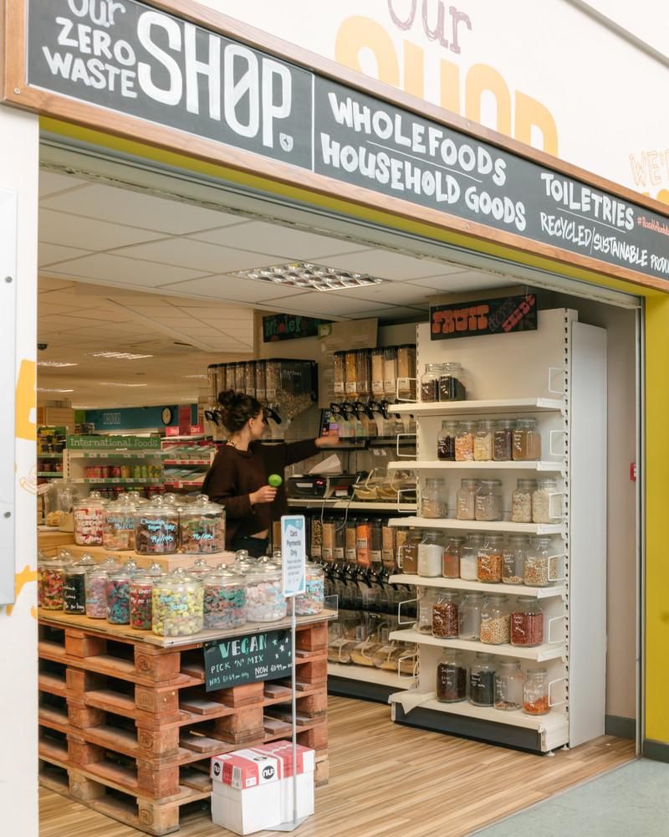
UNIVERSITY
OF THE YEAR
WhatUni Student Choice Awards 2024
PART TIME WORK
SCHOLARSHIPS
STUDENT AMBASSADOR FOR UNIVERSITY
BURSARIES

Slide 27

PART-TIME WORK
Supplement the student loan
Income and invaluable experience plus confidence
The Student Jobshop can help students find part time work
The University is also a regular employer of students
27
Notes:
If you are concerned about having enough money during your time at university, another great way to get extra cash is to get a part time job alongside your studies. A large number of students will look to supplement their student loan with part-time work. Not only does it provide an income stream, but it also provides invaluable experience and confidence. The Student Jobshop can help students find part time work during term time, vacations and for placement years. The University is also a regular employer of students in a variety of roles with generous pay.
Most courses enable you to do this and it is something that is encouraged in order to gain experience and confidence to add these experiences to your CV.
The Student Jobshop can help students find part time work during term time, vacations and for placement years.
The University is a regular employer of students too and pay generously for work to be carried out to work around your studying and exams at uni.

Slide 28

SUMMARY
Budgeting is a skill for life, not just for student life, so the sooner you get good at it, the better!
If you go to university without a plan for your money, it will more than likely catch up on you at some point
Student Finance England​
UK Students: +44 (0) 300 100 0607​
NHS Learning Support Fund
www.nhsbsa.nhs.uk/nhs-learning-support-fund
Disabled Students Allowance
www.gov.uk/disabled-students-allowance-dsa
Which – How much it costs to live at University
which.co.uk/money/university-and-student-finance
UCAS Scholarships and Bursaries tool
https://www.ucas.com/explore/search/scholarships-and-bursaries?query=
28

Slide 29
ACCESS+
As an Access+ student, you’ll have access to support such as:
a contextual offer up to two grades below the standard A Level entry requirements for your course.
our Access+ Travel Bursary
a dedicated team on hand to answer your questions
expert online help and guidance sessions to support you in your journey to higher education
You’ll need to have made Sheffield your firm choice with UCAS for the opportunity to apply for:
an Access+ Transition Mentor
our Access+ IT & Equipment Bursary
If you miss the conditions of your offer we'll still give your application additional consideration on Results Day.
If you have any questions, please contact us at: access@sheffield.ac.uk
For details go to: https://www.sheffield.ac.uk/access-sheffield/plus
29
Notes:
Notes:
Contextual offer: In a small number of cases, we aren't able to issue a lower offer to eligible applicants because of the combination of the qualifications they're taking and the entry requirements for their course. But their application will still receive additional consideration and they can still engage with other elements of Access+
Online sessions - some through Sheffield live and open to all. Other sessions will be by invitation only (usually May) based on personal circumstances
See https://www.sheffield.ac.uk/access-sheffield/plus for must up to date details for links to Travel and It & Equipment bursaries

Slide 30

ACCESS+
You may be eligible for additional support through Access+ if:
You live in an area of disadvantage (2026 entry and beyond)
You were entitled to free school meals
Your personal circumstances mean that:
You’re care experienced
You're a care leaver
You're a carer
You’re estranged from family
You have parenting responsibilities
You’re a forced migrant
To check eligibility criteria visit: https://www.sheffield.ac.uk/access-sheffield/plus
Notes:
Access+ eligibility
Only one criteria needs to be met. However, students may identify with more than one.
Students do not need to apply for Access+ as UCAS applications are reviewed for eligibility:
postcode and FSM checked by US against data set
personal circumstances based on UCAS and/or Access+ Eligibility form
Students who meet the eligibility criteria or not may have additional circumstances that have impacted their studies and should complete the Disrupted Studies form - this will not affect their offer but will mean that they are given additional consideration on results day.

Slide 31




FOR MORE INFORMATION
@sheffielduni
@sheffielduni
The University of Sheffield
@theuniversity
ofsheffield
SHEFFIELD LIVE
sheffield.ac.uk/study/
online-events
TASTER SESSIONS
Sheffield.ac.uk/
undergraduate/visit/
subject-tasters
CHAT TO CURRENT STUDENTS
Sheffield.ac.uk/study/
chat
DON’T FORGET TO…
Ask questions
Do your research
Find what’s right for YOU

Slide 32

ANY QUESTIONS?
Notes:
Research is key
Utilise all available websites and resources to choose the degree that is right for you.
What is most important to you? Location? Facilities? Campus or city?
Remember to book university open days to look around and chat to students and academic staff.

Slide 33


Understanding apprenticeships

Slide 34
Today’s session
What apprenticeships are and the levels
Types of apprenticeships available
How to apply

Slide 35










What are apprenticeships?
Intermediate - degree
Typically 1-6 years
Employed
Off the job
Paid a salary
Real responsibilities
Not the easy option
Contract
700+ standards
Notes:
So what is an apprenticeship?
An apprenticeship is a real job, with a real employer, where the apprentice will work full-time whilst also studying towards a qualification.
So you could be an apprentice working for Sky as a journalist, for example, whilst also studying and gaining a qualification in journalism.
PAID A SALARY
As it’s a real job, you will earn a wage – and it can be a really good salary too! The salary of an apprentice can vary from employer to employer. Legally, an employer must pay an apprentice the National Minimum Wage for apprentices, which is currently £6.40 per hour. This is lower than the normal National Minimum Wage, but it recognises that some people will be going into their first job with little or no experience.
The good news is that lots of employers pay a lot more than the National Minimum Wage for apprentices, with some local employers offering starting salaries of £xx,xxx and other national employers even offering starting salaries over £15,000-£20,000.
I have sourced some local vacancy information, which I will show you in a little while, so you can see some real examples of local and national apprenticeships available and what types of salaries are being offered.
It’s important to remember that if you see an apprenticeship you’re interested in, don’t be put off by the pay if you consider it to be low: there’s room for progression and working your way to the top of an organisation.
CONTRACT
You will also get a contract of employment, holiday pay, annual leave etc. – exactly the same as any other member of staff.
STUDY AND WORK
The apprentice will spend the majority of their time ‘on-the-job’ (doing their role), and a minimum of at least 6 hours per week ‘off-the-job’, which means studying or working towards their qualification.
This study element (off-the-job) will take place with a training provider, who will help them to achieve the qualifications and make sure they complete their apprenticeship.
Training providers could be colleges, universities or independent training provider organisations, who deliver the training/teaching element of the course.
The employer will also support the apprentice, helping an apprentice to gain qualifications and valuable new skills and experience. As well as their time, employers also pay the fees of the apprentice’s training, showing their investment in the apprentice’s development.
TYPICALLY 1 – 6 YEARS
An apprenticeship typically takes 1 to 4 years to complete (sometimes up to 6 for some roles like a solicitor). As a minimum, all apprenticeships must last for at least 12 months.
The total duration will depend on the delivery model that the employer selects (how the mixture of training and working is delivered), the level (which I will explain later on) and the subject they are studying.
700+ STANDARDS and INTERMEDIATE – DEGREE LEVEL
There are more than 600 different apprenticeship standards covering many different levels of apprenticeships, from Level 2 (which is the equivalent of 5 GCSEs), all the way up to Level 7, which is the equivalent to masters level. So you can actually work your way towards gaining a degree or masters through an apprenticeship.
We will discuss this more shortly.
REAL JOB = RESPONSIBILITIES and NOT THE EASY OPTION
As I said before, it’s a real job and so it’s important to remember that apprenticeships aren’t the ‘easy option’.
Holding down a full-time job and studying takes a certain skill and commitment, and it won’t be right for everyone.

Slide 36




Levels of apprenticeships
Intermediate
Advanced
Higher
Degree
Equivalent to:
5 GCSE passes at grade 9-4 (A*-C)
Equivalent to:
2 A levels /
International Baccalaureate
Equivalent to:
Foundation degree and above
Equivalent to:
Bachelors or
masters degree
Level 2
Level 3
Levels 4-7
Levels 6 & 7
Notes:
Each apprenticeship has a level which will fall into one of the four categories above: Intermediate apprenticeships, Advanced apprenticeships, Higher apprenticeships and Degree apprenticeships.
The equivalent to part on the slide helps to explain what level the qualification at the end of the apprenticeship will be, in comparison to more familiar qualifications, like GCSEs and A Levels.
So you can see that if you do a level 3 (advanced) apprenticeship, for example, once you have qualified, you’ll have gained a qualification that is equivalent to 2 A Levels, a level 3 diploma or other equivalents, like IBs or BTECs.
The level of apprenticeship you start at will depend on the kind of job that you are applying for.
It’s really important not to be held back by only looking for a particular level e.g. degree apprenticeships. Apprenticeships work a bit differently to school which can be confusing, as lots of students think that they should progress onto the next level, so if you leave after GCSEs you should do a Level 3 and if you finish after A Levels you should go for a degree apprenticeship, but this isn’t always the case.
Presenter note: Click for animation.
Depending on the sector and apprenticeship, it may be that you need to start at advanced or higher level and work your way up, or that brilliant apprenticeships are only offered at certain levels – for example, an estate agent apprenticeship is offered at Level 2 because that is all the industry requires.
Equally, you may be entering a completely new sector or industry that you haven’t studied or worked in before, and so may need to do a Level 2 or 3 to enter the world of work and start at the correct level of understanding. Doing a job is completely different to getting a GCSE or A Level and that’s why it can be a bit confusing.
It is very important to keep an open mind so that you can explore all of the opportunities available and have multiple options available when applying.

Slide 37
Levels of apprenticeships
Intermediate (L2)
Advanced
(L3)
Higher
Degree
  Furniture maker
  Security operative
  Barber
  Aviation ground handler
  Dog groomer
  Florist
  Accounts assistant
  Pharmacy assistant
  Marina operative
  Junior estate agent
  Engineering technician
  Pastry chef
  Multi-channel marketer
  Fundraiser
  Scenic artist
  Electrician
  Community wellbeing worker
  Data technician
  Visual effects artist
  Town planning assistant
  Sports coach
  Space engineering technician
  Geoscientist
  Accounting manager
  Midwife
  Social worker
  Civil engineer
110+ standards (L4)
110+ standards (L6)
  Vet technician
  Nursing associate
  Rail engineer
  Marine pilot
  Nuclear technician
  Doctor
  Game programmer
  Play therapist
  Solicitor
  Economist
140+ standards
230+ standards
40+ standards (L5)
60+ standards (L7)
Notes:
Presenter note: Please edit this slide with any other apprenticeships that you feel are relevant. Please also remove this slide if you are short on time in your session.
This is just an example of some of the different apprenticeships you can do at different levels, and how many apprenticeships are available at those levels.

Slide 38









Higher & Degree apprenticeships
University fees paid by employer and/or Government
Work full-time and study part-time
No debt
Integrated degree or degree level
Experience
4-6 years
100+ universities (plus colleges, training providers)
Competitive
Progression
Required
Employer selects University/provider
Notes:
Presenter note: Is this slide appropriate for your audience today? Please hide this slide if you do not intend to cover this content.
Higher and degree apprenticeships are a real alternative to following the traditional route of going to university as a full-time student.
They offer the benefits of higher education without the cost and the opportunity to work and gain experience.
It important to remember that no route is better than the other (H&D apprenticeships or full-time University), it is just about which is best/right for you. Everyone has different learning styles and both routes offer a different way to learn and start your career, as well as other life experiences in different ways.
And so we’re going to quickly cover what higher and degree apprenticeships are and how they work so that you have an understanding of what is involved in order to make the best decision for you.
With higher and degree apprenticeships, they work in the same way as other level apprenticeships.
You will not only be learning, but earning a salary from day one, just studying at a level 4 or upwards.
With a degree apprenticeship, your tuition fees are paid for by your employer and the Government, so you will not be expected to pay the £9000 a year tuition fees – and so you will not get any debt.
There are integrated degree apprenticeships (which designs the apprenticeship assessment as a part of the degree), and non-integrated degree apprenticeships where you work towards an existing degree that meets the knowledge requirements of a job. Both mean you come out with a degree level qualification.
You will study the same course content as if you were at university full time, but are able to put it into practice in the workplace straight away while also learning from colleagues. This also helps you to stay up to date on the latest trends and technology in the sector.
With an apprenticeship, it can also be a benefit that you have gained at least 3 years’ work experience whilst completing your degree, which can give you a competitive advantage when applying for future jobs.
But remember – it’s hard work as a degree apprentice. You’ll be working full time and fitting in the equivalent of a full-time degree alongside. It might take a bit longer than studying full-time – for example, 4 years instead of 3, but you’ll achieve the same degree. Some can take as long as 6 years (for example, solicitor apprenticeship).
More than 100 universities in England offer degree apprenticeships now, but there are also colleges and other training providers who will offer apprenticeships.
The employer will select the University, college or training provider that you would study with, this would not be by selection of the apprentice. This will be based on what works best for the employer and will be selected prior to the apprenticeship starting, so it is important to keep an open mind about this and search for the best employer and role as opposed to which training provider they work with, as it will look different for apprenticeships than full-time courses.
The students on degree apprenticeships are entitled to exactly the same benefits as other students, so you will still have access to the student union, sports facilities, clubs, societies and student discounts, as and when this is appropriate.
So there are lots of benefits that come with higher and degree apprenticeships, but as we have said, what works best for you will depend on your career aspirations, the role, how you like to learn and what may be important for you around your next steps.
No matter what kind of career you want to follow, you need to do your research and find out if there’s a way to get to the role you want through an apprenticeship. That way, you can decide if you would prefer to study full time at college or university, or if you would prefer to go into work as an apprentice and gain qualifications and experience on the job from day one.
Remember, you can apply for apprenticeships alongside applying for university and then you can decide what is right for you later on.
It is important to note that they can also be very competitive. Higher and degree apprenticeships are becoming more and more popular because of all of the benefits, so there is lots of interest from young people and others.
So school/college leavers absolutely can apply for degree apprenticeships and you’ll see many brilliant young people achieving them, but as we discussed earlier, it’s important to keep your options open and consider routes through apprenticeships also e.g. starting at a level 2 or 3 and progressing into a degree apprenticeship.
Data shows that the majority of school leavers going into apprenticeships start at a level 2 or level 3 (where there are more vacancies available) and then may move into higher or degree apprenticeships.
There is no set time for when you need to apply for a degree apprenticeship – you can apply to another level and work your way up.
It’s also important to check what is required for the job role you are interested in. Do they require a degree level apprenticeship or are they offering other routes.

Slide 39
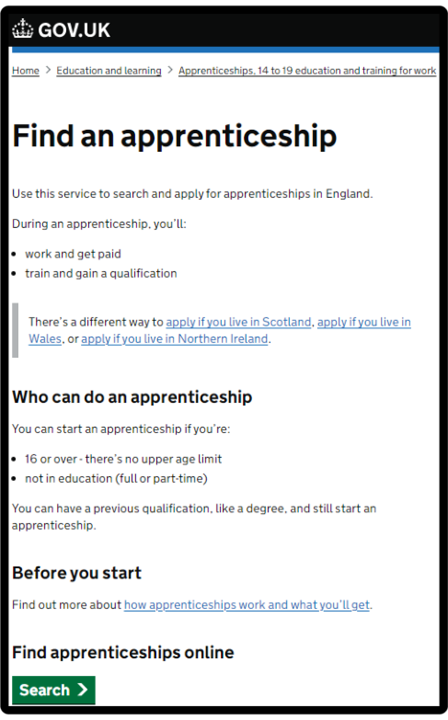





How do you find apprenticeships?
WHAT IS FAA?
Showcasing live apprenticeship jobs
20,000+ vacancies
over the year
Free to use
Secure site
Apply quickly
Notes:
Where did I find these vacancies? So one of the first places to look is Find an apprenticeship, the government portal for apprenticeship jobs.
It’s really important that you register. Search the internet for ‘Find an apprenticeship’ and it will come up as the first link.
The search page is on gov.uk, an official government site.
Have a look at the different jobs that are being advertised. Remember, this is a live jobs site so it may be that you need to try and few different searches or to broaden how far you are looking to find jobs that you are interested in. It also means different vacancies will come up at different times so do not be disheartened if you don’t find something straight away, you may want to look again at another time or on different jobs/employer websites.
Start applying for jobs that interest you. You need to remember that typically, some of the bigger companies will advertise quite early in the year (e.g. September/October) for apprentices to start the following September so please don’t leave it until the last minute or you might be disappointed to have missed a great opportunity.
Others may come up later in the year closer to the time you are looking to start your apprenticeship, so use the website to help you with the next step.
Set up your alerts. A great feature of this system is that you can get it to do all the hard work for you. You can manage your alert settings so that you receive emails when jobs come up that you might be interested in.
Employers are always telling us that the applicants that really stand out to them are those that have made a bit of extra effort. You could consider contacting the company and asking them if they have any virtual open days coming up, or work experience or other opportunities to engage with them. That will look really impressive on your application and can give you an advantage over other applicants.
Find an apprenticeship has some new features so we will be working with you to create an account / can share information about resources that will help you to set up an account.

Slide 40
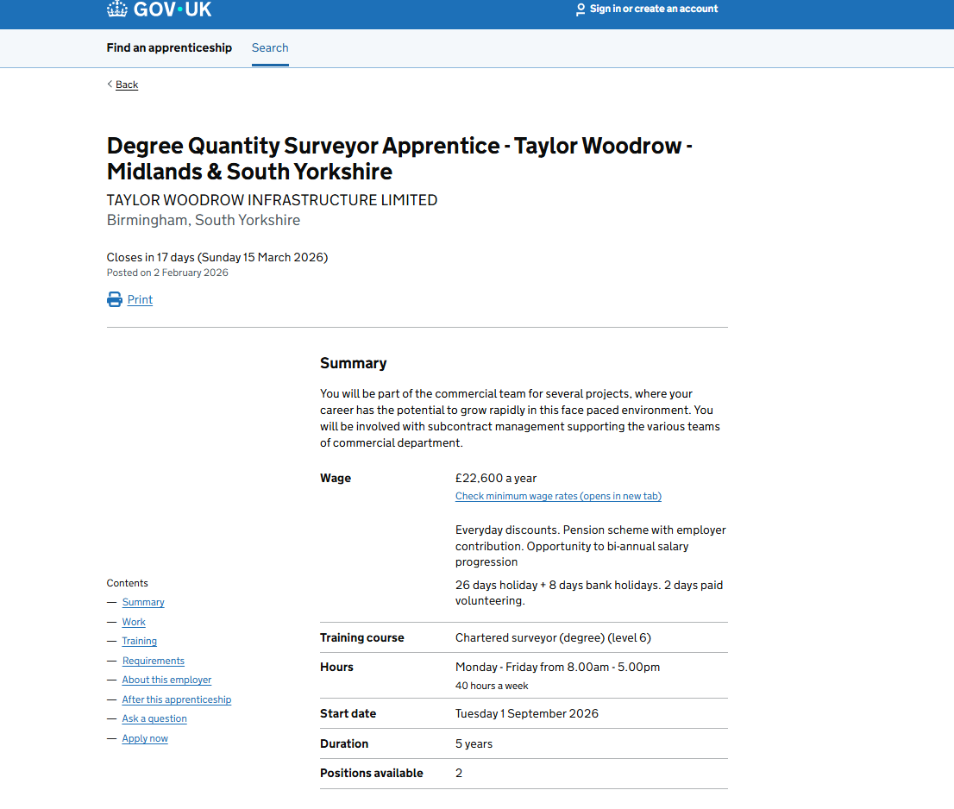

Slide 41
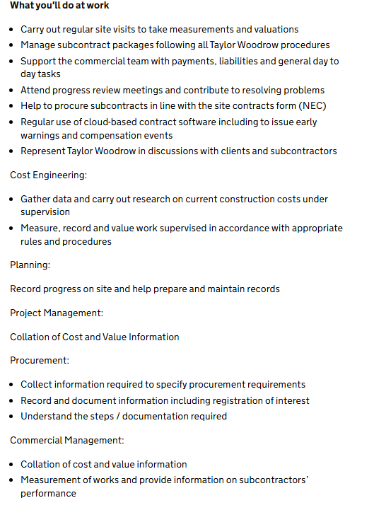

Slide 42
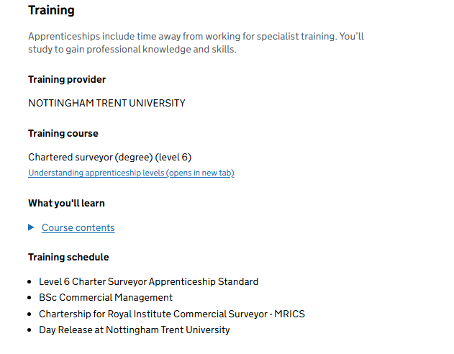

Slide 43
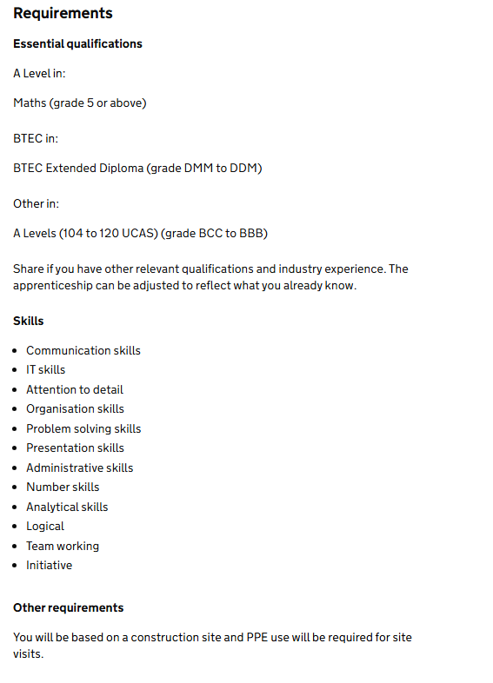

Slide 44
Finding apprenticeships
No one place to look
Many employers advertise on their own websites
Very competitive
On average students make 15-20 applications

Slide 45
Where to look for apprenticeships
Company website
Social media
LinkedIn
Direct contact to companies
Word of mouth
Job sites

Slide 46
What are employers looking for?
Usually grades 4 and above Maths and English
Grades usually similar to the degree course
Punctuality and attendance at school
Enthusiasm for the role
Commitment to apprenticeship

Slide 47
What to put in your application
Show examples of your skills in your application
Show why you want to work for that company
Time management skills
Refer to job description in application
Any gaps that you need to work on?

Slide 48







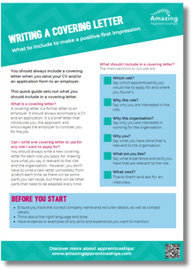

Useful websites & resources
Resources to support you in applying
Choices Magazine
Application guides
Webinars
Podcast
Resources
Employer profiles
www.amazingapprenticeships.com
Notes:
There are an array of resources to support you and your child in researching apprenticeships and how to search and apply for opportunities.
There is a monthly ‘Choices’ magazine produced by Amazing Apprenticeships which is available on their website and on the CEC website. They are really useful and contain lots of different articles and guidance for you, including on apprenticeships as well as other technical pathways like T Levels.
Your school may circulate this to you, but you can also subscribe to receive it by visiting Amazingapprenticeships.com/vacancies.
For other useful information and more resources, you can also go to www.amazingapprenticeships.com.
Amazing Apprenticeships deliver a series of online workshops on behalf of the DfE which are available for parents and carers. These run on a monthly basis and explore apprenticeships and careers options for your child.
There are some other brilliant resources available, including parent/carer guides, podcasts and films.
The web address is showing on the screen now so please make a note of it.

Slide 49




Find out more
www.careersandenterprise.co.uk
www.nationalcareers.service.gov.uk/
www.amazingapprenticeships.com
Notes:
You can also visit the Careers & Enterprise Company website and for more information about apprenticeships.
There is also support available through the National Careers Service, who provide careers information advice and guidance.

Slide 50



What’s in it for you?
Free, tailored mentoring from an award-winning undergraduate studying your desired subject at your desired uni.
Double your chances of reaching a top university!
Gain exclusive access to our Into Careers mentoring platform once you’re at university.

Slide 51



Interested?
Apply now!
Title
Title
Questions?
hello@zerogravity.co.uk

Slide 52

Any questions?
Thank you for participating
Notes:
Before we finish, I know we’ve covered a lot today so I wanted to check if there are any final questions at all?
Presenter note: Suggested interactivity: You could do a poll/raise of hands to gauge confidence/knowledge levels after the assembly.
For any further questions, please pass them onto your teacher and I can make sure to follow up with them afterwards, but in the meantime, I just wanted to share some useful websites where you can find out more about apprenticeships.

Slide 53
Thank you for your attendance

