Slide 1
Ridgewood School’s Y11 Revision Evening
Guidance for great results

Slide 2
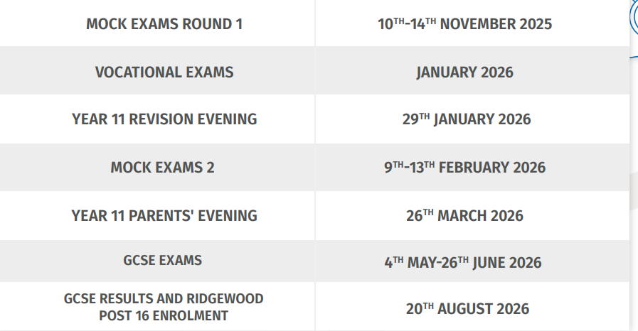
Key Dates (Page 2 of the Revision Guide)
6 School Days until mock exam starts.
51 School Days until your real exams.
CF1 Current Attainment and Teacher Predictions sent home December 2024
CF2 Current Attainment and Teacher Prediction sent home March 2025
Mock Grades will be provided to students in school

Slide 3
Support in School
Every lesson counts
Feedback from assessments
Revision guidance
Key questions/topics for exams
Further curriculum time
PDP intervention groups
Wellbeing support
Validus and teachers

Slide 4
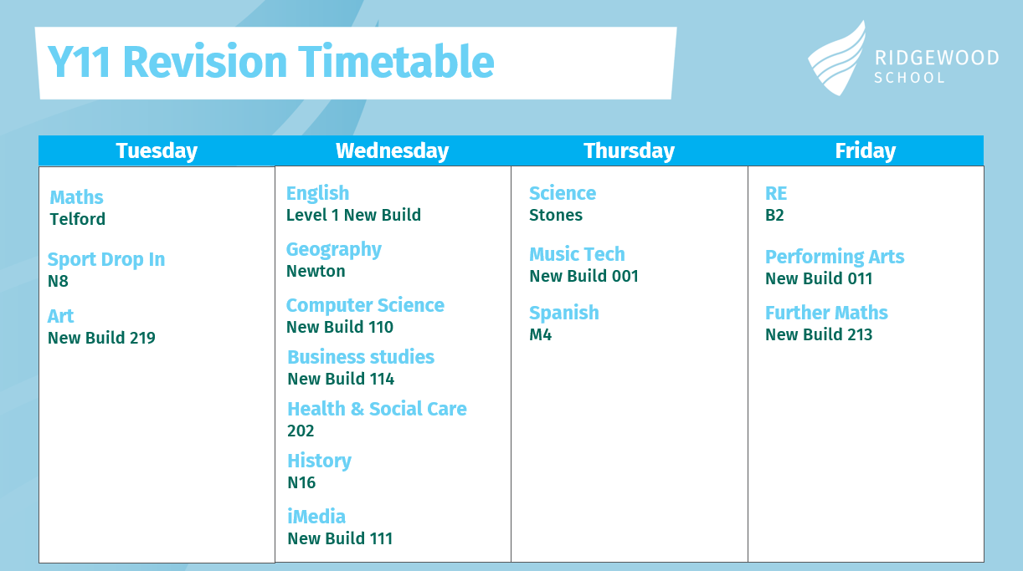
Support afterschool

Slide 5
Mocks and Exams- Expectations
All students will receive a timetable for their mocks and exams with clear rooms and seat numbers.
Students need to enter the exam hall/room in silence
  Labels must be off water bottles.
  Pencil cases must be clear.
  Any paper in your pockets will need to be in your bag in the separate area.
  Mobiles will need to be off and in your bag.
  Students cannot bring any type of watch into the exam hall.
  No electronic devices allowed at all (inc. headphones/smart glasses).
  No writing is allowed on their hand/arm.
If students are seen with these (even if you are not using them) it will lead to disqualification from the exam. Staff remind students at least three times before the exam begins of these rules.

Slide 6



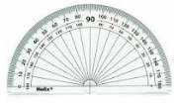
Mocks and Exams- Reminder
You need to have the correct equipment for your exams, this will make you not only feel better prepared and less stressed but is often the key to gaining more marks.
You need to always have the following available:
2 black pens
Pencil (and sharpener would be sensible!)
Rubber
Ruler
Casio scientific calculator (no case)
Compass
Protractor
You must let your form tutor or teacher know if you are struggling to get the correct equipment a few days before the exams, we will help anyone who needs our support.

Slide 7
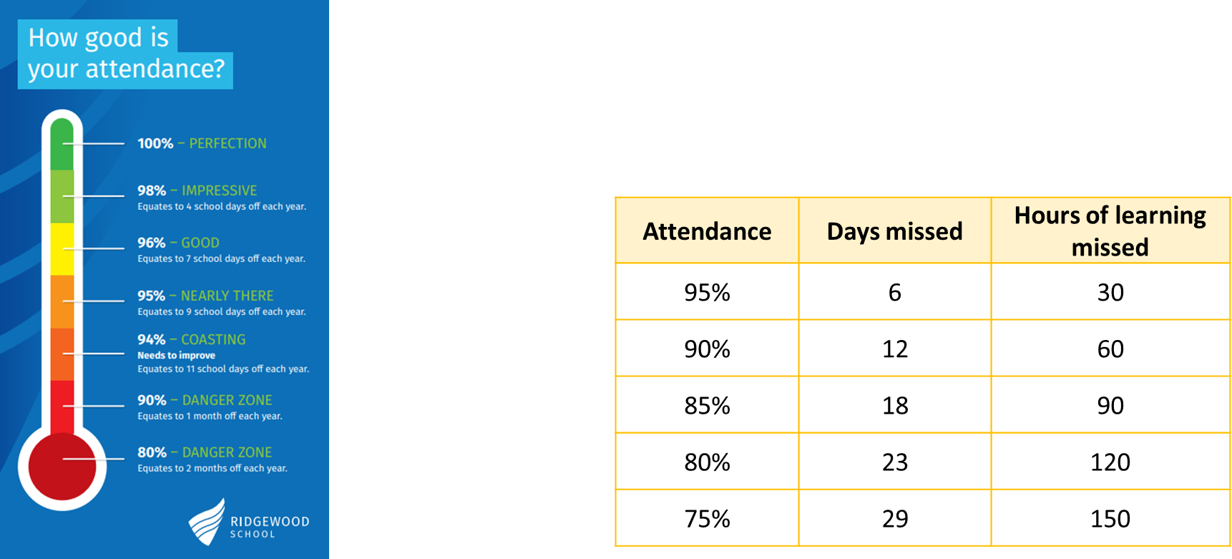
How can I help my child prepare?
Ensure they’re in school as much as possible

Slide 8
How can I help my child prepare?
Research and experience shows that children whose parents/carers take the opportunity to be frequently interested in their child’s learning make most progress. -The Campaign for Learning
Links to videos and further support page 2 of revision guide

Slide 9
How can I help my child prepare?
Ensure they’re in school as much as possible
Ensure they have the correct equipment
Check their mock/exam timetable
Create a supportive space in your home for revision
Check their revision timetable and hold them to account
Remember helping them do their work is not the same as doing it for them
Discussing work with them strengthens their understanding
Let them be the teacher – if you don’t know anything about what they need to know in a subject – ask them to teach you
Reinforce positivity and encourage breaks to support well-being

Slide 10
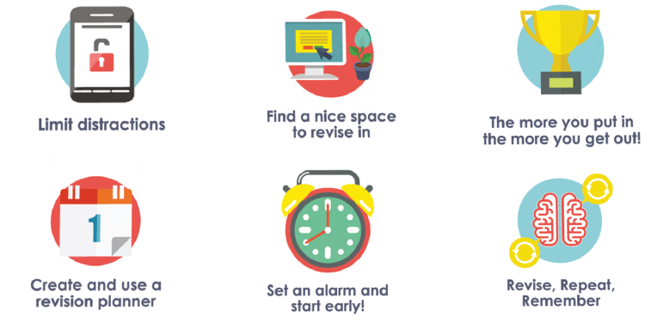
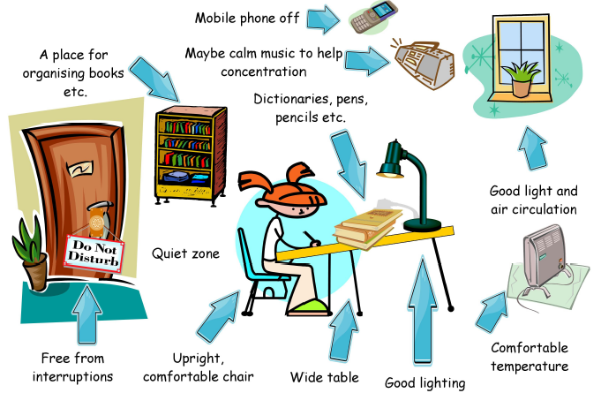
How can I help my child prepare?
Create a supportive space in your home for revision

Slide 11

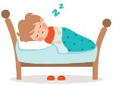
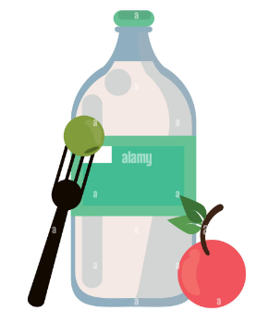



How can I help my child prepare?
Reinforce positivity and encourage breaks to support well-being
Notes:
1- Prioritise sleeping well (8-10hours)
2- Stay hydrated and eat healthy
3- Take breaks for hobbies and relaxing
4- Plan your time and manage it well to feel on top of things
5- Talk to friends and other adults, reminder of Validus
6- Celebrate your achievements, no matter how small and be positive

Slide 12





Revision myths
Silence improves recall by 76%
Notes:
Just reading= doesn’t work
Just highlighting does not work, pretty work doesn’t mean good work
You must do something with the information, write bullet points/mindmaps to summarise or follow up with questions
Silence is better than music, especially music with lyrics, recall improves by 76% according to studies
Pretty work doesn’t mean productive work
Lots of work without checking answers

Slide 13
How can I help my child prepare?
Check their revision timetable and hold them to account
Remember helping them do their work is not the same as doing it for them
Flash cards and self testing- take part by asking questions
Deliberate practice- check your child is doing work by hand, writing working and writing their own notes rather than reading/highlighting
Interleaving and spacing- check your child is revising in chunks across a range of subjects and topics
Use the revision guide handed out tonight for further subject specific advice including websites and revision workbooks etc.

Slide 14
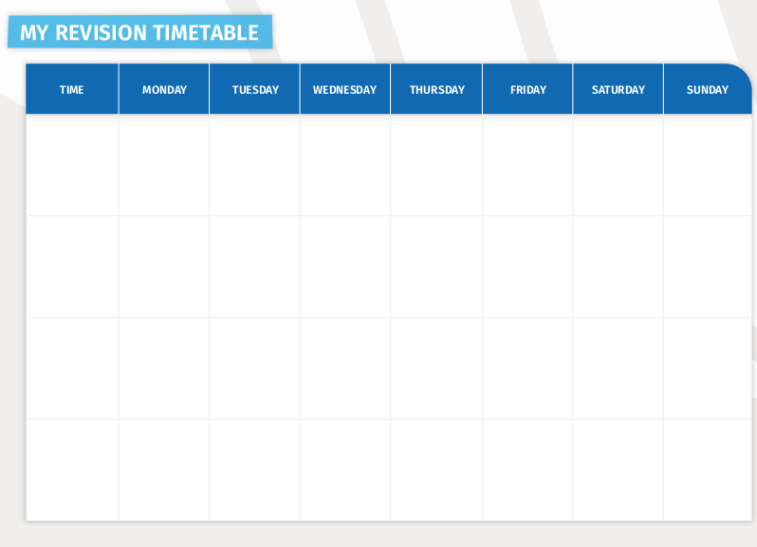
Page 7
Use strategies learnt tonight and from the booklet page 3 – 5

Slide 15

WAGOLL example
Time | Mon | Tues | Wed | Thurs | Fri | Sat | Sun
After school
Science
English
Maths
RE
4-4.30
Coursework/homework
RE
Biology
English
Chem
Gaming
4.30-5
Out with friends/family
English
Maths
Geog
Sport
English
5-5.30
Maths
Geog
Physics
Maths
Biology
Sport
5.30-6
Chem
Maths
RE
Englishpractice full question
Physics
RE
Football
6-6.30
Sport
Homework
Coursework/homework
Geog
Homework
Notes:
After school opportunities, much cheaper than a tutor and teachers that know you!
Fill in the times that you want to reserve- work (although at this point ensure your hours are minimal), sports/clubs, socialising
Reserve further time for coursework or homework activities, homework is revision and is important!
Spread out your subjects, interleave and space
Week by week be aware of exactly what topics you plan to revise and how

Slide 16
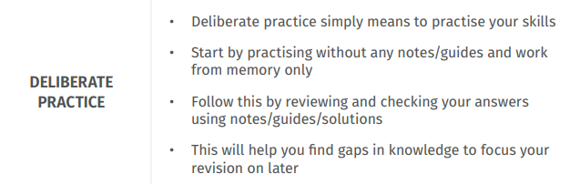

Slide 17

Deliberate practice examples
Mark using the model solutions or success criteria
In a different colour pen make corrections and/or additions to improve the number of marks/grade
Complete as much of the question as possible to the best of your ability independently
Find a past exam question, exam style question or past paper
Example sites:
www.mathsgenie.co.uk/gcse
www.kerboodle.com
https://www.aqa.org.uk/subjects/science/gcse/science-8464/assessment-resources?secondaryResourceType=Question+papers
More to be found on specific subject pages in the Revision Guide

Slide 18
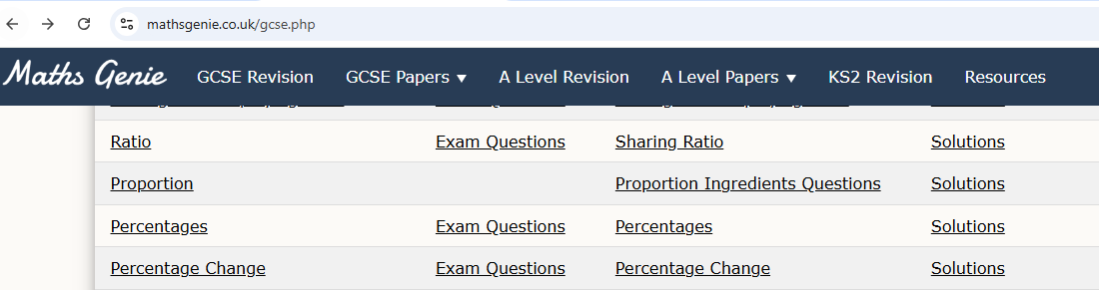
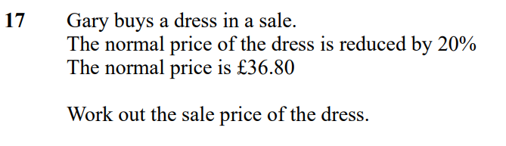
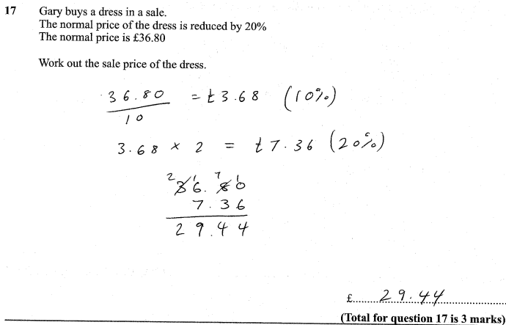
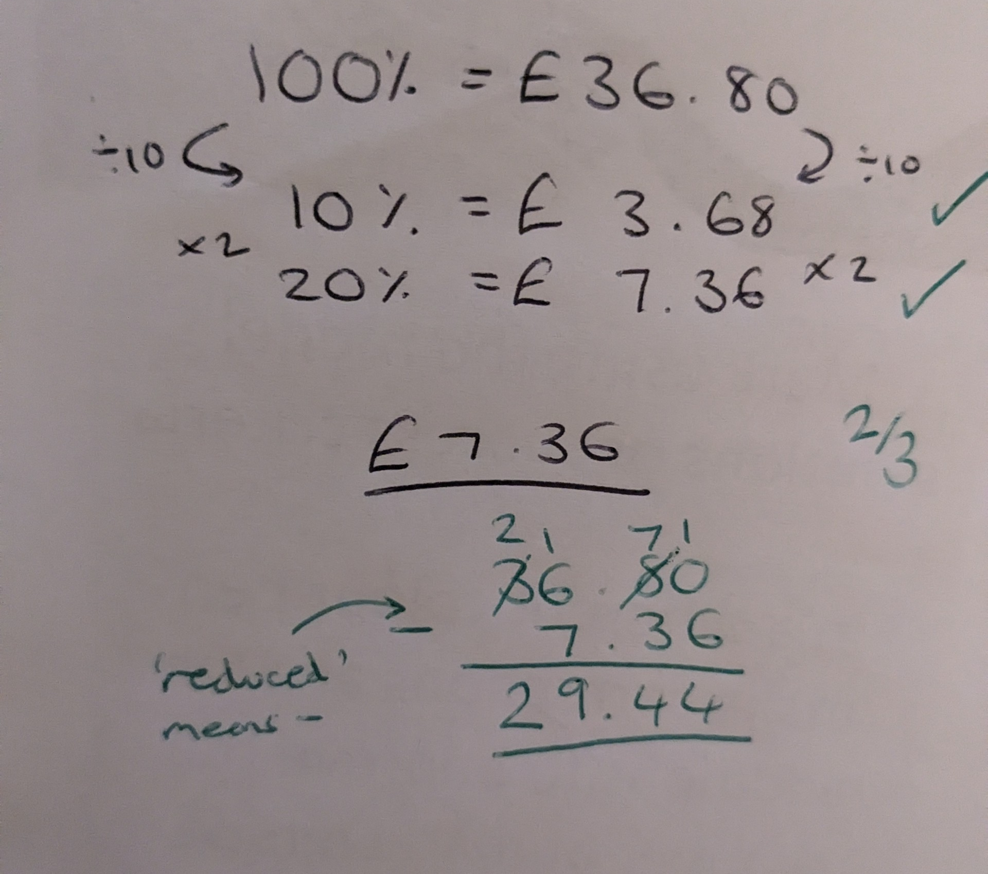
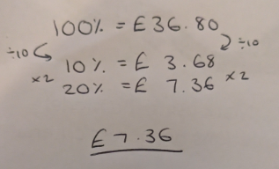

Slide 19
Summarising and Chunking
Read the text in full
Skim the text again, you can highlight and annotate key information at this point
Summarise: Write a small paragraph of the overarching theme of the text
Chunk: Break down the key points using a table or subtitles
Use bullet points to write key points in your own words, be concise

Slide 20
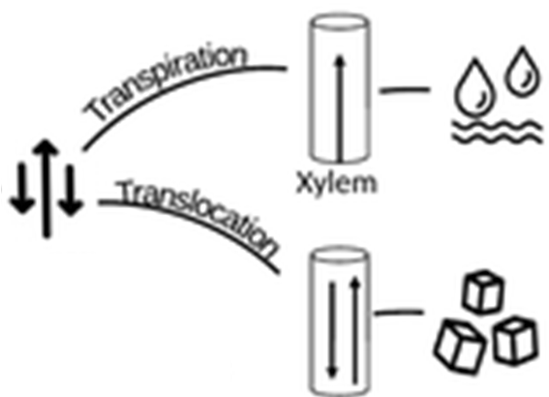

Dual coding
Students who revised with words and pictures performed twice as well in a problem solving test compared to those who had just revised with just words
Could be used for…
Processes in Science and Geography
Recalling timelines in History and Geography
Translations in Spanish
During deliberate practice for Maths

Slide 21

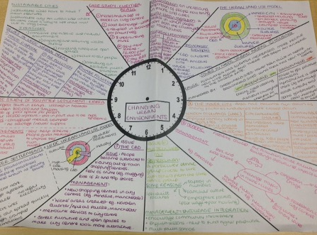
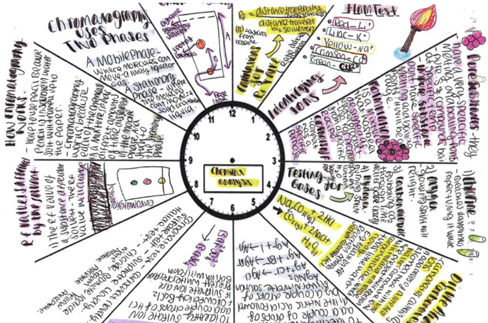
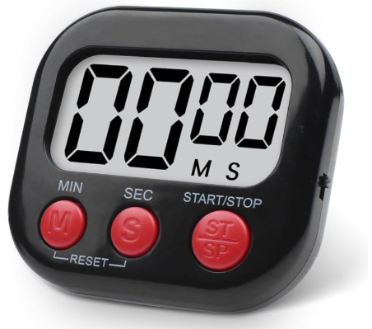
Revision clocks
Choose a topic and break it down into 12 main categories
Revise each section for 5 minutes
Grab a blank clock and see how much you can recall for each section

Slide 22
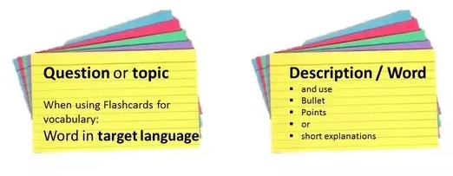
Flash Cards
Best for key facts and definitions e.g.
Definitions for Science
Quotes for English Lit
Events and dates for History
Facts and figure for Geography
Translations in Spanish
Types of market research in Business

Slide 23
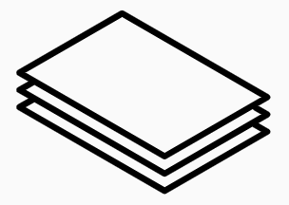
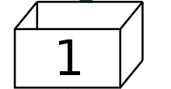
Flash Cards
When you answer correctly, move to the next box
When you answer correctly, move to the next box
Monday
Tuesday & Thursday
Friday
If you answer incorrectly, move to the previous box

