Slide 1
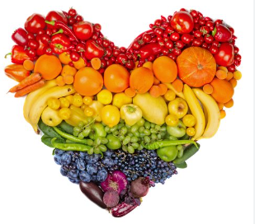
Food technology
Year 9 recipes
September to December 2025
Name:…………………………………..
Class:…………….
Teacher:……………….
Day and period of lesson:………….
Recipe | Date
Knife skills – provided by school
Fruit scones
Twisted bread
Apple tray bake
Pastry triangle
Stained glass window biscuits
Date and week commencing | Monday 9b/tk1/2 p4 | Tuesday | Wednesday 9a/tk5/6 p4 | Thursday 9a/tk3/4 p1 9b/tk5/6 p3 | Friday 9a/tk1/2 p1 9b/tk3/4 p2
15/09/25 A | Knife skills |  | Knife skills | Knife skills | Knife skills - MWY
22/09/25 B |  |  |  |  | Knife skills- LSG
29/09/25 A | Fruit scones |  | Fruit scones | Fruit scones | Fruit scones
13/10/25 A | Twisted bread |  | Twisted bread | Twisted bread | Twisted bread
Half term
03/11/25 A |  |  | Stained-glass window biscuits | Stained-glass window biscuits | Stained-glass window biscuits
17/11/25 A | Apple tray bake |  | Apple tray bake | Apple tray bake | Apple tray bake
01/12/25 A | Pastry triangles |  | Pastry triangles | Pastry triangles | Pastry triangles
15/12/25 A | Stained-glass window biscuits
You will need your ingredients weighed out at home, and an apron and container labelled with your name.
All students are expected to take part in practical lessons, please use the contact us button if you have any questions, or need to pass any information on to the class teacher.

Slide 2
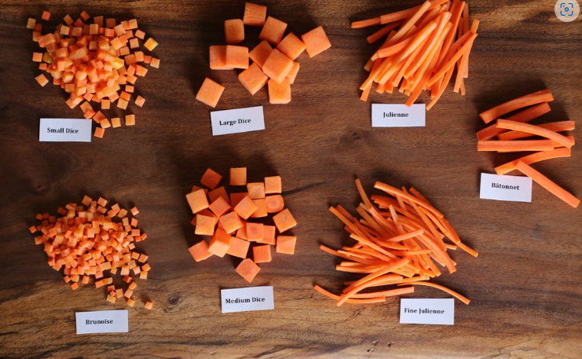
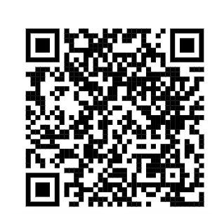
Knife skills
School will provide the carrots but see if you can practice at home, under guidance of your parents or carer.
Scan the link for the practice video.

Slide 3
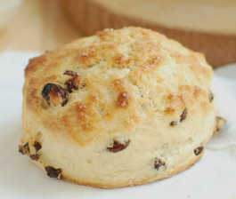
Fruit scones
Ingredients
225g self raising flour
55g hard block butter or margarine
50g raisins or other dried fruit of your choice
150ml milk
25g sugar
Suitable sized container

Slide 4
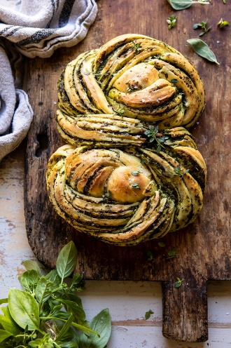
Twisted bread
250g strong bread flour
1 packet yeast
1 teaspoon sugar
Pinch of salt
Or 250g Bread mix
160ml warm water
Filling
75g of the cheese of your choice e.g. mature cheddar, grated mozzarella or a mozzarella ball, Cheshire
4tbsp of caramelised onion chutney or tomato puree or sundried tomato puree.
Stretch- make your own caramelised onion chutney at home
-1 red onion sliced, 1tbsp oil, 1tbsp sugar, 1tbsp vinegar-(balsamic is good but any will do), salt and pepper.
1-2 tbsp water as needed- simmer gently for about 20 mins

Slide 5
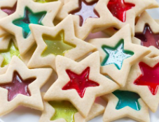
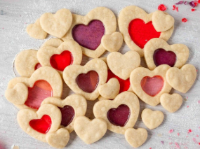
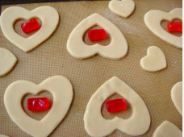
Stained glass window biscuits
Ingredients
100 g butter or block margarine
50 g sugar
150 g plain flour
8 boiled sweets (the cheap ones)
A suitable container

Slide 6
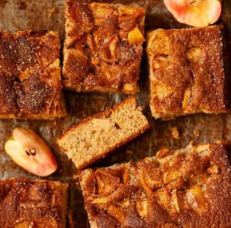
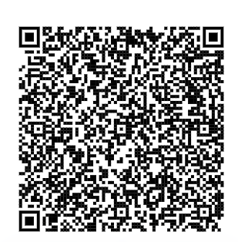
Apple tray bake
Ingredients
100g caster sugar
100g butter or soft baking spread
2 eggs
100g self raising flour
1 eating apple
1 x 5ml spoon cinnamon
1 x 5ml spoon demerara sugar OR CASTER SUGAR
A 20cm x 20cm baking tray – for example a brownie tray - see QR code for example below

Slide 7
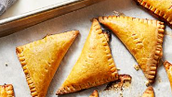
Pastry triangles
Ingredients
100g plain flour
50g butter or block baking margarine
2 – 3 x 15ml spoons cold water
1 egg
1 tablespoon sugar to sprinkle on top
Filling of your choice e.g.
1 apple
OR
1 banana and 40g chocolate
OR
6 teaspoons of jam or biscoff spread (PLEASE NO NUT PRODUCTS)
Note you will only need a small amount of filling.

